Slide 1

Bringing data pipelines to production, with Airflow
Jake Roach
Notes:
Business problem: have a data team, but not a consistent way to run pipelines in production. This presentation will offer a solution; using Airflow to run your data pipelines in production.

Slide 2

Jake Roach
🏡
Buffalo, NY
👨🏻‍💻
Data Engineer and Instructor
⛳️
150 rounds of golf with my wife!

Slide 4



Growing a data team that’s manually building and running data pipelines, creating analyses, and developing models, but without a tool to centrally manage all these moving parts
Develop and run workflows as code in a centralized platform
Unlock tools to supercharge data pipelines
Monitor and manage data pipeline execution
Notes:
If you’re thinking about Airflow, you’re probably running some sort of homegrown data pipeline solution

Slide 5
Apache Airflow
DAG (directed-acyclic graph)
Programmatically define data pipelines
Dynamic
Extensible
Flexible
DAGs
Schedule, retry, alert
Monitor data workflows
extract
transform
load
https://airflow.apache.org/docs/apache-airflow/stable/index.html
Notes:
What is Apache Airflow?
- Open source tool to programmatically define data pipelines
Dynamic: since pipelines can be defined using Python
Extensible: pre-built functionality, ability to add your own
Flexible (or robust): Easy to configure for variations without a major code change

Slide 6
Extracting, transforming, and loading market data
Pull data from the Polygon API
Flatten the JSON response
Transform the flattened response
Load the transformed DataFrame to a Postgres database

Slide 7
market_data_etl.py
def extract():
# Pull data from an API for today’s date
market_date = "2023-12-08"
raw_response = requests.get(f"https://...{market_date}")
...
return raw_dataset
def transform(raw_dataset):
# Transform the raw dataset
...
...
# Execute the ETL
raw_dataset = extract()
cleaned_dataset = transform(raw_dataset)
load(cleaned_dataset)
Homegrown data pipelines require additional features to be production-grade
Schedule
Policy on retries
Store sensitive credentials
Visibility into execution details
Lots of custom code
> python3 market_data_etl.py
Notes:
What are three things that Airflow can do for your data organization?
If you’re thinking about Airflow, you’re probably running some sort of home grown data pipeline solution, that may look something like this
Maybe using a tool like Lambda to run this, with little observability
- What if it fails?
- How do you re-run?
Executed by hand, daily
Lives on a single team member’s machine
Little monitoring and observability

Slide 8
Airflow makes data pipelines production-ready
extract_market_data
PythonOperator
Scheduled to run daily, each morning
Retry on failure
Securely store and retrieve sensitive credentials
Persist execution details before run
Use traditional Airflow operators to build a DAG
flatten_market_data
PythonOperator
transform_market_data
PythonOperator
load_market_data
PythonOperator
Notes:
Other requirements for the first DAG

Slide 9
dags/market_etl__traditional.py
# Instantiate the DAG
with DAG(
dag_id="market_etl__traditional",
start_date=datetime(2023, 8, 1),
end_date=datetime(2023, 8, 31),
schedule="0 9 * * 1-5"
...
) as dag:
# Create tasks using traditional operators
extract_market_data = PythonOperator(
dag=dag,
task_id="extract_market_data",
python_callable=extract_market_data__callable
)
...
# Set dependencies between tasks
extract_market_data >> ... >> load_market_data
Provide a DAG ID, start date, schedule interval
{
{
Programmatically define tasks
Set dependencies between tasks
{
Notes:
Show DAG 1
Code on the right/left
- DAG definition
- Traditional operator
Graph on the right/left

Slide 10
with DAG(
...
default_args={
"retries": 3,
"retry_delay": timedelta(minutes=1)
}
) as dag:
Configure custom retry policy
Securely retrieve variables in code
Share data between tasks with XComs
polygon_api_key = Variable.get("POLYGON_API_KEY")
flatten_market_data = PythonOperator(
dag=dag,
task_id="flatten_market_data",
python_callable=flatten_market_data__callable,
op_kwargs={"raw_dataset": "{{ ti.xcom_pull(task_ids='extract_market_data') }}"}
)
Notes:
Default args
Python Callables
Share data between tasks

Slide 11
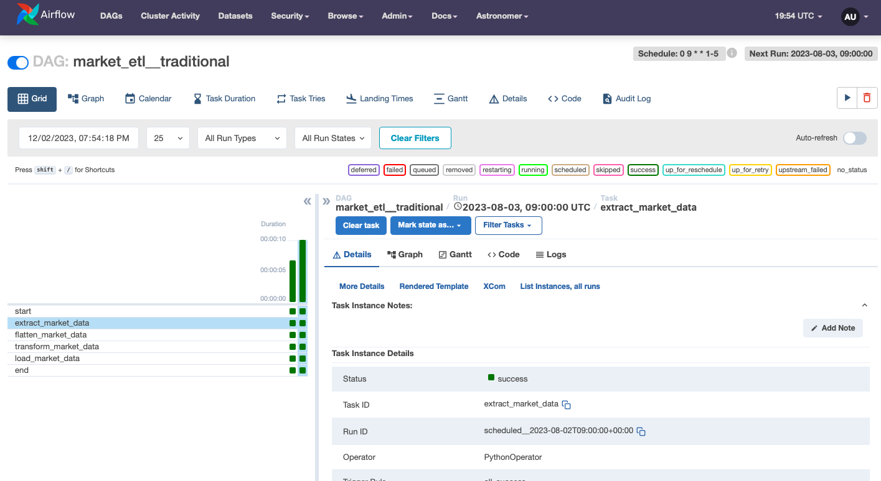

Slide 12
Airflow makes writing production-ready data pipelines a breeze
Schedule DAG runs
Ability to retry on failure
Securely interact with source systems and destinations
Single “pane of glass” into pipeline execution details
TaskFlow API makes getting started with Airflow even easier
Notes:
Intro to the TaskFlow API

Slide 13


The TaskFlow API makes writing DAGs more intuitive for data teams
@dag
@task
DAGs and tasks defined as functions
Useful when passing information between tasks
Makes Airflow more accessible to data scientists and analysts
Notes:
Summary of the TaskFlow API
Python Tasks
Abstracts passing data with Xcoms

Slide 14
dags/market_etl__taskflow_api.py
{
@dag(
start_date=datetime(2023, 8, 1),
end_date=datetime(2023, 8, 31),
schedule="0 9 * * 1-5”,
...
)
def market_etl__taskflow_api():
@task()
def extract_market_data():
...
return raw_dataset
@task()
def flatten_market_data(raw_dataset, **context):
...
raw_data = extract_market_data()
flattened_data = flatten_market_data(raw_data)
transformed_data = transform_market_data(flattened_data)
load_market_data(transformed_data)
market_etl__taskflow_api()
Same parameters as traditional DAG definition
{
Intuitive process to create tasks
Easy to share data between tasks and set dependencies
{
Notes:
To enable this DAG to be run, the market_etl__taskflow_api function needs to be called

Slide 15
The TaskFlow API helps data teams provide immediate business value with Airflow
Easier to port Python ETL logic to Airflow DAGs
Make Airflow more accessible
Maintaining the best functionality of DAGs and tasks
Astro Python SDK extends this functionality

Slide 16
Extracting, transforming, and loading market data with Airflow
extract_market_data
PythonOperator
Extracted, transformed, and loaded market data
Schedule, visibility into pipeline execution, securely interact with data assets
Use both traditional Airflow operators and TaskFlow API
flatten_market_data
…
transform_market_data
@task
load_market_data
@task
Notes:
Summary of DAG 1 (traditional and TaskFlow)
… Helping to take a manually run data pipeline into a production-ready state

Slide 17



Airflow reduces the code needed to integrate your data stack
TaskFlow API
Variables and Connections
Jinja templating at run-time
Ever-growing number of pre-built operators to help orchestrate workflows
Notes:
Talk about other functionality, operators, extensibility

Slide 18
Automating analytics workflows
update_guest_attendance_view
SQLExecuteQueryOperator
update_inventory_view
SQLExecuteQueryOperator
start
end
EmptyOperator
update_item_sales_view
EmptyOperator
SQLExecuteQueryOperator
update_labor_view
SQLExecuteQueryOperator

Slide 19
dags/daily_operations_view_update.py
...
# Define tasks using SQLExecuteQueryOperator
update_guest_attendance_view = SQLExecuteQueryOperator(
dag=dag,
task_id="update_guest_attendance_view",
postgres_conn_id="postgres_daily_operational_conn",
sql="""
CREATE OR REPLACE VIEW admissions_by_entrance AS (
SELECT
...
WHERE admission_date = '{{ ds }}'
...
);"""
)
...
# Set dependencies between tasks
start >> [update_guest_attendance_view, update_labor_view, ...] >> end
SQLExecuteQuery-Opeartor
Easily connect to data sources and destinations
}
}
Use Jinja templating to render runtime
}
Allow view updates to run in parallel
Notes:
DAG2

Slide 20
Add a templated path to store SQL files
with DAG(
...
template_searchpath="include/sql"
...
) as dag:
...
update_inventory_view = SQLExecuteQueryOperator(
dag=dag,
task_id="update_inventory_view",
postgres_conn_id="postgres_daily_operational_conn",
sql="update_inventory_view.sql"
)
...
{
Provide path to SQL file in operator call
{
Create connection with Astro CLI
{
> astro dev run connections add ... <connection-name>
Notes:
DAG2

Slide 21



Using pre-built operators streamlines data pipeline data development
Reduces custom code to build a DAG
Workflows are easier to read and troubleshoot
Leverage Jinja template engine
Notes:
DAG2

Slide 22
Airflow makes complex data pipeline development simple
Pulling from disparate sources
Mix of traditional operators and TaskFlow API
Task groups and branching logic
Custom operators
Notes:
Complex DAG definitions

Slide 23
start
EmptyOperator
check_market_open
guest_attendance_replication_task_group
labor_replication_task_group
@task.branch
postgres_to_s3
postgres_to_s3
process_market_data
CustomPostgresToS3Operator
CustomPostgresToS3Operator
…
market_closed_notification
EmptyOperator
extract_market_data
s3_to_snowflake
s3_to_snowflake
@task
CustomS3ToSnowflakeOperator
CustomS3ToSnowflakeOperator
flatten_market_data
@task
transform_market_data
@task
archive_s3_files
EmptyOperator
load_market_data
@task
end
EmptyOperator
Notes:
DAG 3, no code
Graph view
Talk about services involved
Write your own operators

Slide 24
Task groups help to delineate similar tasks within a DAG
process_market_data
@task_group(group_id="process_market_data")
def process_market_data():
# Add tasks to task group
...
extract_market_data
@task
flatten_market_data
@task
with TaskGroup(
group_id="process_market_data"
) as task_group:
# Add tasks to task group
...
transform_market_data
@task
load_market_data
@task
Notes:
Talk about the business case for DAG 3
All of the benefits and features used

Slide 25
Branching allows for complex logic to be implemented in pipelines
check_market_open
@task.branch
def check_market_open(**context):
...
# Branch between two options
if is_weekend or is_market_holiday:
return ["market_closed_notification"]
return ["process_market_data.<task-name>"]
...
@task.branch
process_market_data
market_closed_notification
EmptyOperator
extract_market_data
@task
...
Notes:
Probably another for DAG 3

Slide 26
Custom operators leverage Airflow’s extensibility meet to your data team’s needs
Implement custom logic
Extends existing functionality
Easy to reuse across DAGs
labor_replication_task_group
postgres_to_s3
CustomPostgresToS3Operator
s3_to_snowflake
CustomS3ToSnowflakeOperator
Notes:
Probably another for DAG 3

Slide 27


Airflow simplifies developing and maintaining data workflows of all types
Programmatically define data pipelines
Single-pane of glass into orchestration environment
Leverage tools to supercharge your data pipelines
Notes:
Reiterate Airflow benefits
Mention managed service like Astro

Slide 28

Astronomer provides out-of-the-box tools to run Airflow in production
The leading managed service provider for Airflow
Easy to create and maintain Airflow environments, without managing the infrastructure
Astro CLI, Registry, Astro Python SDK
+
https://www.astronomer.io/product/
Notes:
Use this link for code styling: https://docs.astronomer.io/learn/airflow-decorators

Slide 29


Obstacles
Creating a complex data workflow with a limited stack
Enable Airflow to make the biggest impact
Notes:
Obstacles I ran into

Slide 30
Notes:
Questions for me

Slide 31

Appendix
https://github.com/jroachgolf84/astronomer-panel-interview
https://airflow.apache.org
https://airflow.apache.org/docs/apache-airflow/stable/index.html
https://www.astronomer.io
Notes:
Appendices

